Slide 1

By-
NAVIN KUMAR
IPL AUCTION

Slide 2
Bidding on batters
Your first priority is to get 2-3 players with high S.R who have faced at least 500 balls. And to do that you have to make a list of 10 players you want to bid in the auction so that when you try to grab them in auction you should not pay the amount greater than you have in the purse for a particular player.
Now you need to get 2-3 players with good Average who have played more the 2 IPL seasons. And to do that you have to make a list of 10 players you want to bid in the auction so that when you try to grab them in auction you should not pay the amount greater than you have in the purse for a particular player.
Now you need to get 2-3 Hard-hitting players who have scored most runs in boundaries and have played more the 2 IPL season. To do that you have to make a list of 10 players you want to bid in the auction so that when you try to grab them in auction you should not pay the amount greater than you have in the purse for a particular player.

Slide 3
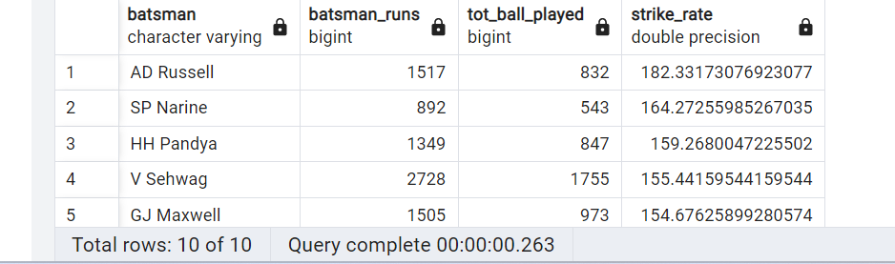
1. Your first priority is to get 2-3 players with high S.R who have faced at least 500 balls. And to do that you have to make a list of 10 players you want to bid in the auction so that when you try to grab them in auction you should not pay the amount greater than you have in the purse for a particular player.
Solution:
To calculate batting strike rate in cricket:
Divide the number of runs scored by balls faced by the batter.
Strike rate = (runs scored / balls faced) × 100.
Query :
select batsman, sum(batsman_runs) as batsman_runs,
count(ball) as tot_ball_played,
cast(sum(batsman_runs) as double precision)/count(ball)*100 as
Strike_rate from ipl_ball
where extras_type not in ('wides’)
group by batsman
having count(ball)>=500 order by Strike_rate desc
limit 10;
Conclusion: These batsmen have all been able to consistently score runs quickly, which has helped their teams to win matches. They all have different strengths, but they all share a common goal of being aggressive and scoring runs.

Slide 4
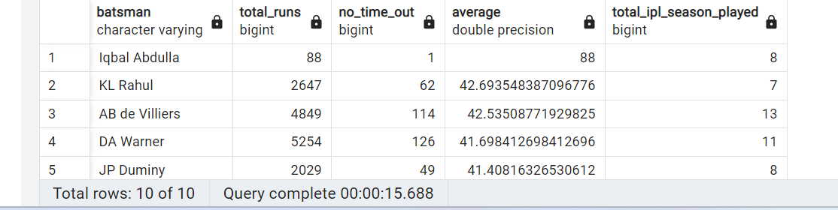
2. Now you need to get 2-3 players with good Average who have played more the 2 ipl seasons. And to do that you have to make a list of 10 players you want to bid in the auction so that when you try to grab them in auction you should not pay the amount greater than you have in the purse for a particular player.
Solution:
Players with good Average : It is calculated by dividing the total runs scored by the number of times the batsman has been dismissed
Query :
SELECT batsman, (SELECT SUM (batsman_runs) FROM ipl_ball WHERE ipl_ball.batsman = match.batsman) AS total_runs,
COUNT(CASE WHEN is_wicket = 1 THEN 1 ELSE NULL END) AS no_time_out,
cast((SELECT SUM(batsman_runs) FROM ipl_ball WHERE ipl_ball.batsman = match.batsman) as double precision)/NULLIF(count(case when is_wicket=1 then 1 else null end),0) as Average ,
count(distinct(extract(year from date))) as total_ipl_season_played
FROM ipl_ball AS match
inner join ipl_match as b on match.id=b.id
WHERE dismissal_kind NOT IN ('retired hurt', 'obstructing the field')
GROUP BY batsman
having count(distinct(extract(year from date)))>2
order by Average desc limit 10;
Conclusion: These batsmen have all been able to consistently score runs over a long period of time, which has helped their teams to win matches. They all have different strengths, but they all share a common goal of being reliable and scoring runs.

Slide 5
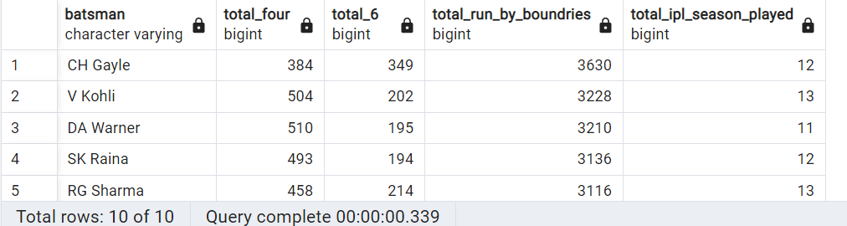
3. Now you need to get 2-3 Hard-hitting players who have scored most runs in boundaries and have played more the 2 ipl season. To do that you have to make a list of 10 players you want to bid in the auction so that when you try to grab them in auction you should not pay the amount greater than you have in the purse for a particular player.
Query :
SELECT batsman, COUNT (CASE WHEN batsman_runs = 4 THEN 1
ELSE NULL END) AS total_four,
COUNT(CASE WHEN batsman_runs = 6 THEN 1 ELSE NULL END) AS total_6, sum(batsman_runs) as total_run_by_boundries, count(distinct(extract(year from date))) as total_ipl_season_played
FROM ipl_ball b
inner join ipl_match m
on b.id=m.id where batsman_runs in(4,6)
group by batsman
having count(distinct(extract(year from date)))>2
order by total_run_by_boundries desc
limit 10;
Conclusion: These players have all been able to consistently hit the ball a long way, which has helped their teams to win matches. They all have different strengths, but they all share a common goal of hitting big shots and scoring runs.

Slide 6
Bidding on Bowlers
Your first priority is to get 2-3 bowlers with good economy who have bowled at least 500 balls in IPL so far. To do that you have to make a list of 10 players you want to bid in the auction so that when you try to grab them in auction you should not pay the amount greater than you have in the purse for a particular player.
Now you need to get 2-3 bowlers with the best strike rate and who have bowled at least 500 balls in IPL so far. To do that you have to make a list of 10 players you want to bid in the auction so that when you try to grab them in auction you should not pay the amount greater than you have in the purse for a particular player.

Slide 7
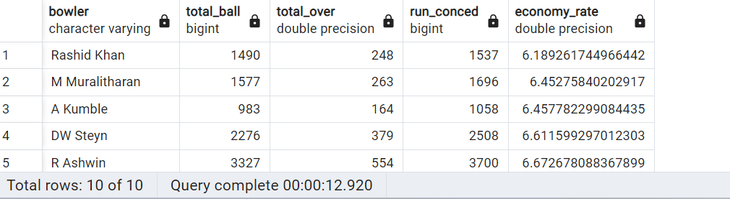
Your first priority is to get 2-3 bowlers with good economy who have bowled at least 500 balls in IPL so far. To do that you have to make a list of 10 players you want to bid in the auction so that when you try to grab them in auction you should not pay the amount greater than you have in the purse for a particular player.
Solution:
Calculating a bowler's economy rate:
Economy rate = Runs conceded / Overs bowled
Query :
select bowler, (SELECT count(ball) FROM ipl_ball WHERE ipl_ball.bowler = match.bowler) AS total_ball,
round(cast((SELECT count(ball) FROM ipl_ball WHERE ipl_ball.bowler = match.bowler)as double precision)/6) as total_over,
sum(total_runs) as run_conced ,
cast(sum(total_runs) as double precision)/(cast((SELECT count(ball) FROM ipl_ball WHERE ipl_ball.bowler = match.bowler)as double precision)/6)
as economy_rate
from ipl_ball as match
where extras_type not in ('byes','legbyes','penalty’)
group by bowler
having (SELECT count(ball) FROM ipl_ball WHERE ipl_ball.bowler = match.bowler) >=500 order by economy_rate limit 10;
Conclusion: These bowlers have all been able to consistently restrict the scoring rate, which has helped their teams to win matches. They all have different strengths, but they all share a common goal of being economical and effective.

Slide 8
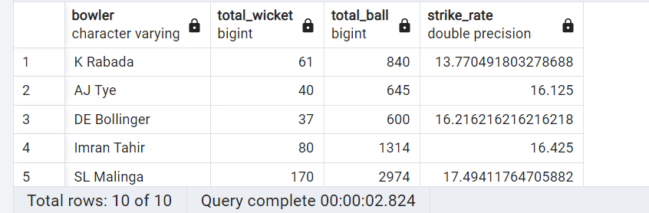
2. Your Now you need to get 2-3 bowlers with the best strike rate and who have bowled at least 500 balls in IPL so far. To do that you have to make a list of 10 players you want to bid in the auction so that when you try to grab them in auction you should not pay the amount greater than you have in the purse for a particular player.
Solution:
Bowling strike rate is calculated as total balls bowled / wickets taken by bowler.
Query :
select bowler, count(case when is_wicket=1 then 1 else null end) as total_wicket,
(SELECT count(ball) FROM ipl_ball WHERE ipl_ball.bowler = match.bowler) AS total_ball,
cast((SELECT count(ball) FROM ipl_ball WHERE ipl_ball.bowler = match.bowler) as double precision)/NULLIF(count(case when is_wicket=1 then 1 else null end),0) as Strike_rate
from ipl_ball as match
Where dismissal_kind not in ('obstructing the field','retired hurt','run out')
group by bowler
having count(ball)>=500 order by Strike_rate limit 10 ;
Conclusion: These bowlers have all been able to consistently take wickets quickly, which has helped their teams to win matches. They all have different strengths, but they all share a common goal of being effective and taking wickets.

Slide 9
Bidding on All rounders
Now you need to get 2-3 Allrounders with the best batting as well as bowling strike rate and who have faced at least 500 balls in IPL so far and have bowled minimum 300 ball. To do that you have to make a list of 10 players you want to bid in the auction so that when you try to grab them in auction you should not pay the amount greater than you have in the purse for a particular player.

Slide 10
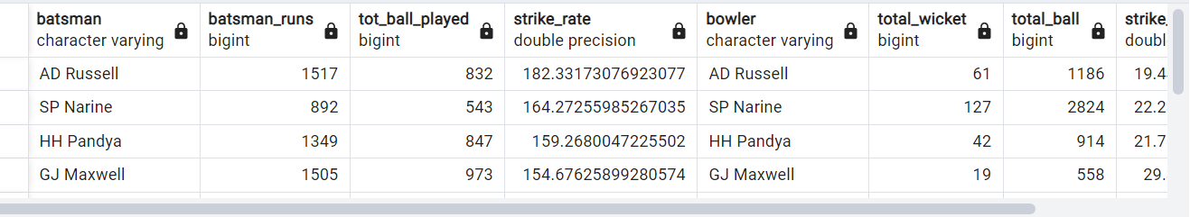
Query :
Step 1: create a table for batting_strike_rate
create table batting_strike_rate as (select batsman, sum(batsman_runs) as batsman_runs, count(ball) as tot_ball_played, cast(sum(batsman_runs) as double precision)/count(ball)*100 as Strike_rate from ipl_ball where extras_type not in ('wides') group by batsman having sum(ball)>=500 order by Strike_rate desc);
Step 2: create a table for bowling_strike_rate
create table bowling_strike_rate as (select bowler, count(case when is_wicket=1 then 1 else null end) as total_wicket,
(SELECT count(ball) FROM ipl_ball WHERE ipl_ball.bowler = match.bowler) AS total_ball, cast((SELECT count(ball) FROM ipl_ball WHERE ipl_ball.bowler = match.bowler) as double precision)/NULLIF(count(case when is_wicket=1 then 1 else null end),0) as Strike_rate from ipl_ball as match where dismissal_kind not in ('obstructing the field','retired hurt','run out’) group by bowler having count(ball)>=500 order by Strike_rate) ;
Step 3: Query to fetch All-rounders with the best batting as well as bowling strike rate
select a.batsman, a.batsman_runs,a.tot_ball_played,a.Strike_rate,b.bowler,b.total_wicket,b.total_ball,b.strike_rate from batting_strike_rate as a inner join bowling_strike_rate as b
on a.batsman=b.bowler
where a.tot_ball_played>=500 and b.total_ball>=300
order by a.Strike_rate desc,b.strike_rate limit 10;
Conclusion: These players have all been able to consistently contribute with both bat and ball, which has helped their teams to win matches. They all have different strengths, but they all share a common goal of being valuable to their teams.

Slide 11
Additional Questions for Final Assessment
1. Get the count of cities that have hosted an IPL match
2. Create table deliveries_v02 with all the columns of the table ‘deliveries’ and an additional
column ball_result containing values boundary, dot or other depending on the total_run
(boundary for >= 4, dot for 0 and other for any other number)
(Hint 1 : CASE WHEN statement is used to get condition based results)
(Hint 2: To convert the output data of the select statement into a table, you can use a
subquery. Create table table_name as [entire select statement].
3. Write a query to fetch the total number of boundaries and dot balls from the
deliveries_v02 table.
4. Write a query to fetch the total number of boundaries scored by each team from the
deliveries_v02 table and order it in descending order of the number of boundaries
scored.
5. Write a query to fetch the total number of dot balls bowled by each team and order it in
descending order of the total number of dot balls bowled.
6. Write a query to fetch the total number of dismissals by dismissal kinds where dismissal
kind is not NA
7. Write a query to get the top 5 bowlers who conceded maximum extra runs from the
deliveries table
8. Write a query to create a table named deliveries_v03 with all the columns of
deliveries_v02 table and two additional column (named venue and match_date) of venue
and date from table matches
9. Write a query to fetch the total runs scored for each venue and order it in the descending
order of total runs scored.
10. Write a query to fetch the year-wise total runs scored at Eden Gardens and order it in the
descending order of total runs scored.

Slide 12
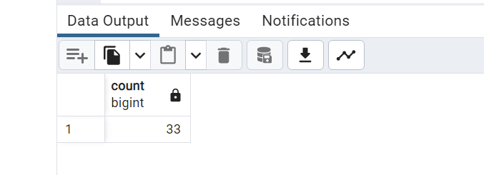
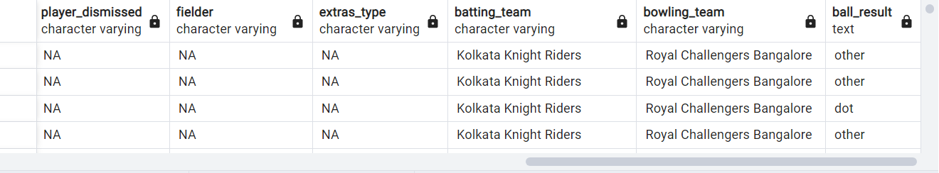
Get the count of cities that have hosted an IPL match
2. Create table deliveries_v02 with all the columns of the table ‘deliveries’ and an additional column ball_result containing values boundary, dot or other depending on the total_run (boundary for >= 4, dot for 0 and other for any other number) (Hint 1 : CASE WHEN statement is used to get condition based results) (Hint 2: To convert the output data of the select statement into a table, you can use a subquery. Create table table_name as [entire select statement].
Query :
select count(distinct city) from ipl_match;
Query :
create table deliveries_v02 as select *,
case
when total_runs >= 4 then 'boundary’
when total_runs = 0 then 'dot’
else 'other’
end as ball_result
from ipl_ball;

Slide 13
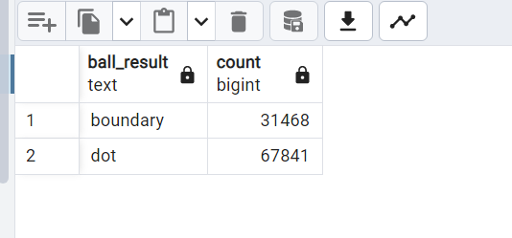
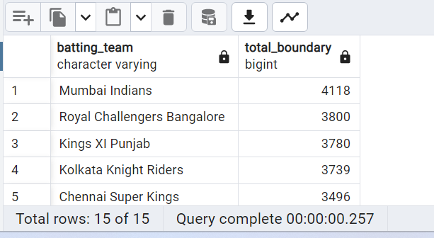
3. Write a query to fetch the total number of boundaries and dot balls from the deliveries_v02 table.
4. Write a query to fetch the total number of boundaries scored by each team from the deliveries_v02 table and order it in descending order of the number of boundaries scored.
Query :
select ball_result, count(*) from deliveries_v02
where ball_result='boundary' or ball_result='dot’
group by ball_result;
Query :
select batting_team, count(ball_result) as total_boundary
from deliveries_v02 where ball_result='boundary’
group by batting_team order by total_boundary desc;

Slide 14
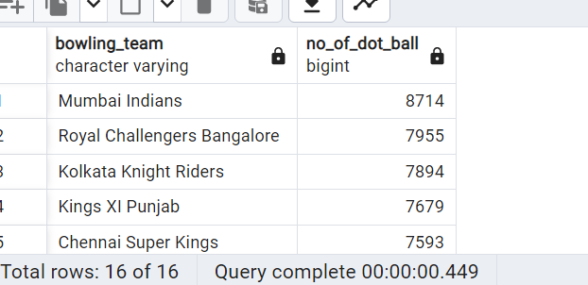
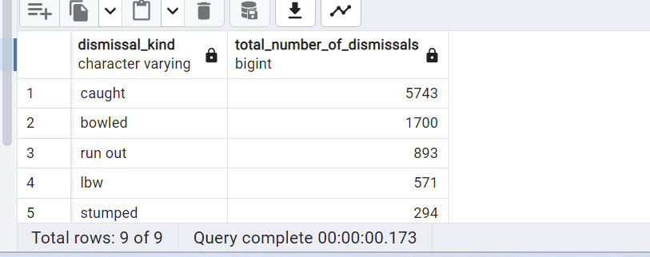
5. Write a query to fetch the total number of dot balls bowled by each team and order it in descending order of the total number of dot balls bowled.
6. Write a query to fetch the total number of dismissals by dismissal kinds where dismissal kind is not NA.
Query :
select bowling_team, count(ball_result) as no_of_dot_ball from deliveries_v02
where ball_result='dot’
group by bowling_team order by no_of_dot_ball desc;
Query :
select dismissal_kind, count(*) as total_number_of_dismissals
from deliveries_v02 where dismissal_kind not in ('NA') group by dismissal_kind order by total_number_of_dismissals desc;

Slide 15
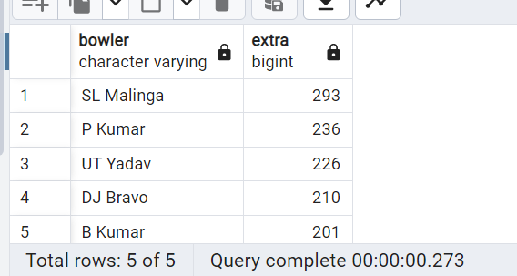
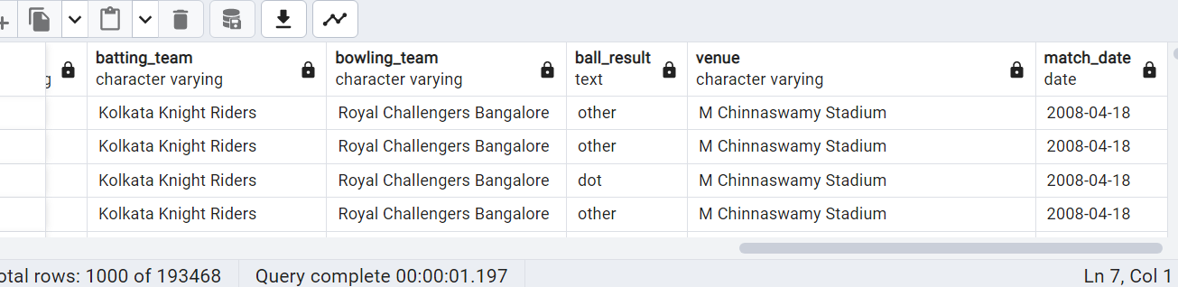
7. Write a query to get the top 5 bowlers who conceded maximum extra runs from the deliveries table
8. Write a query to create a table named deliveries_v03 with all the columns of deliveries_v02 table and two additional column (named venue and match_date) of venue and date from table matches
Query :
select bowler, sum(extra_runs) as extra from deliveries_v02
group by bowler order by extra desc limit 5;
Query :
create table deliveries_v03 as
select del_2.*, m.venue, m.date as match_date
FROM deliveries_v02 as del_2
left join ipl_match as m
ON del_2.id = m.id;

Slide 16
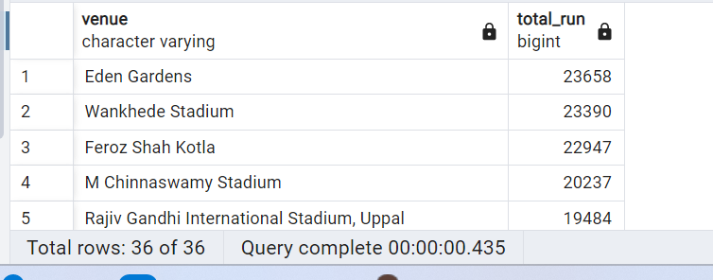
9. Write a query to fetch the total runs scored for each venue and order it in the descending order of total runs scored.
Query :
select venue, sum(total_runs) as total_run
from deliveries_v03 group by venue order by total_run desc;

Slide 17
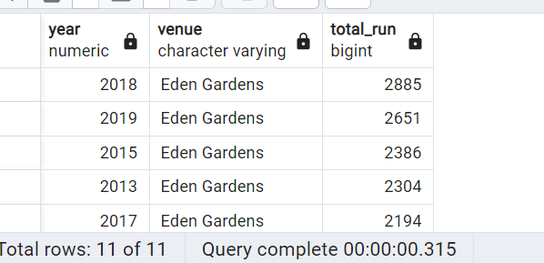
10. Write Write a query to fetch the year-wise total runs scored at Eden Gardens and order it in the descending order of total runs scored.
Query :
select extract(year from match_date) as year, venue ,
sum(total_runs) as total_run
from deliveries_v03 where venue='Eden Gardens'
group by year, venue order by total_run desc;

Slide 18

Thank You

